Slide 1
Lesson 9
Remote Sensing
Notes:
https://www.youtube.com/watch?v=jVXgWGK9Kr8

Slide 2
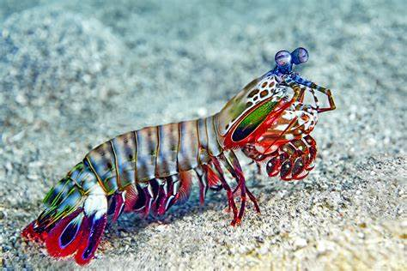
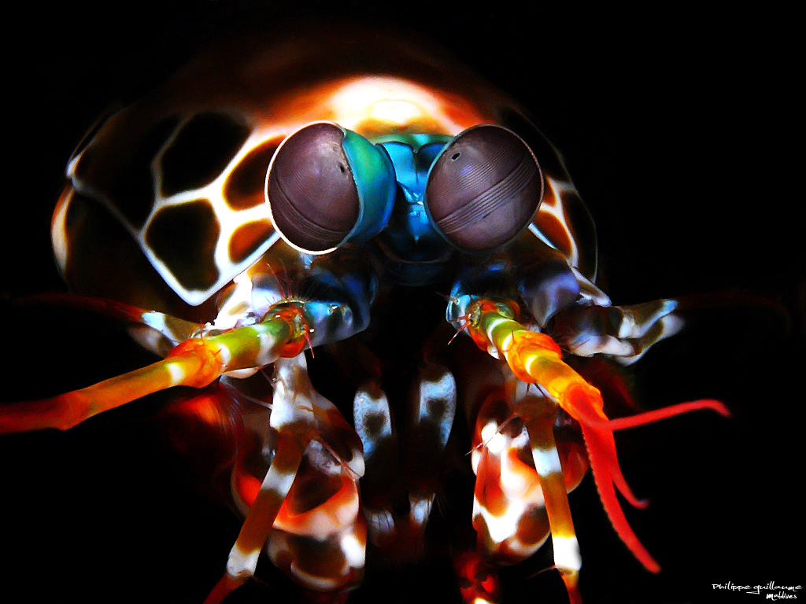
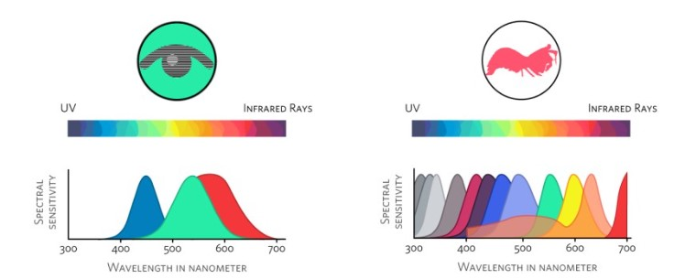
What is this? (and why is it special?)
Notes:
Mantis shrimp vision is one of the most extraordinary sensory systems in the animal kingdom. Their eyes are often called nature’s most complex visual organs, and studying them has influenced everything from evolutionary biology to biomimetic sensor design.
Eye Structure
Compound eyes: Like many crustaceans, mantis shrimp have compound eyes, but with unique specializations.
Each eye is mounted on a stalk and can move independently, giving nearly 360° vision.
The eye has three distinct regions:
Dorsal hemisphere
Ventral hemisphere
Midband (a specialized strip with rows of ommatidia responsible for advanced spectral and polarization sensitivity).
Because of this structure, each eye can see depth on its own (trinocular vision within a single eye), unlike humans, who require two eyes for stereoscopic depth.
Spectral Sensitivity
Humans see 3 color channels (red, green, blue).
Mantis shrimp have 12–16 different types of photoreceptor cells sensitive to different wavelengths.
Their spectral coverage spans ultraviolet (UV), visible light, and even into the far-red.
Despite this, experiments suggest they don’t perceive “color” the way we do (blending channels into a continuous spectrum). Instead, they may use a lookup-table style system—quickly identifying spectral signatures without complex processing.
This system is thought to enable ultra-fast color recognition, useful in dynamic reef environments.
Polarization Vision
Mantis shrimp can detect:
Linear polarization (orientation of light waves).
Circular polarization (spiral-shaped waveforms)—a capability almost unique in the animal kingdom.
Some species even produce circularly polarized signals on their body for communication, invisible to most predators.
Functional Advantages
Communication: Many species use polarized patterns and colors on their exoskeleton for signaling.
Predation & hunting: Their vision helps spot transparent prey, detect prey buried in sand, or see through camouflage.
Navigation: UV and polarization cues are used to orient on reefs.
Survival: Independent eye movement and polarization detection give them awareness of predators and rivals.
Inspirations for Technology
Biomedical imaging: Polarization-sensitive detection can enhance cancer diagnostics.
Hyperspectral cameras: Designs mimicking mantis shrimp eyes may allow compact sensors.
Optical communication: Circular polarization channels for secure data transfer.
In short, mantis shrimp don’t just “see more colors”—they see the world in fundamentally different ways, combining color, polarization, and depth perception in ways no human or most other animals can.
Would you like me to also sketch a diagram of their eye structure and midband rows so it’s easier to visualize?

Slide 3
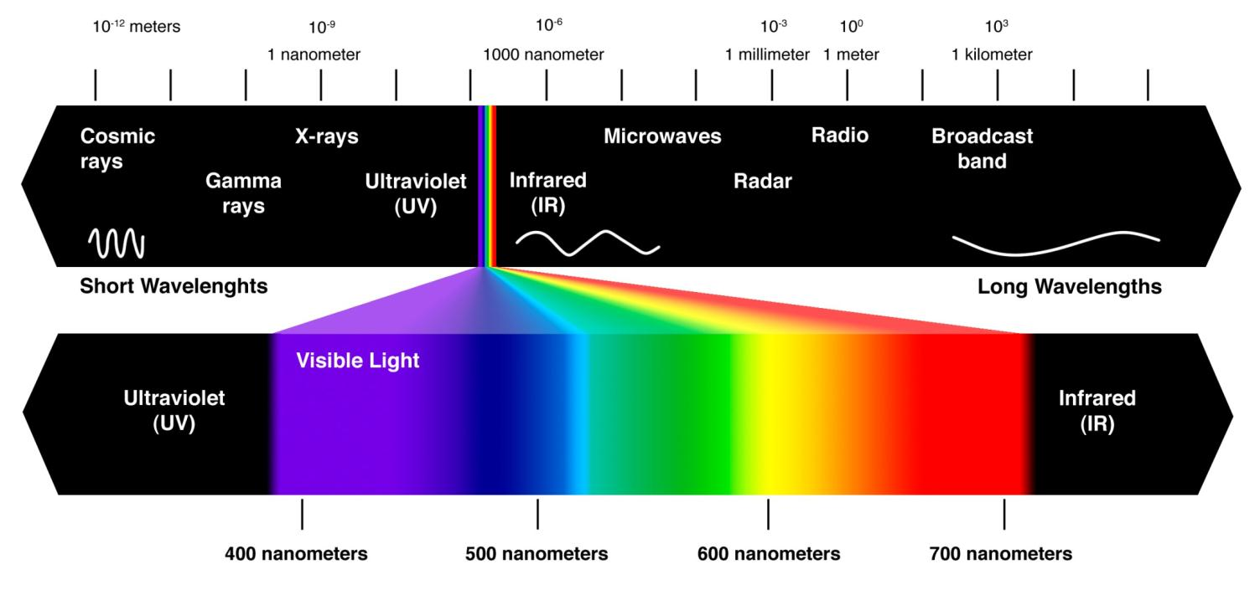

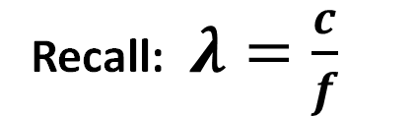
Electromagnetic Spectrum (again)
Recall: $λ=\frac{c}{f}$
Notes:
https://www.youtube.com/shorts/7mPGyMGglC0

Slide 4
EM Spectrum: Useful Bands for Remote Sensing
Region | Approx. λ | Typical use / what you learn
UV | 0.2–0.4 µm | Ozone/aerosols, fluorescence; strong atmospheric effects.
Visible (RGB) | 0.4–0.7 µm | True color, water/leaves/soil color, turbidity, bathymetry in clear water.
Red-edge | ~0.70–0.75 µm | Vegetation chlorophyll transition; stress/senescence sensitive.
NIR | 0.75–1.0 µm | Healthy vegetation (high reflectance), water is dark → NDVI (Red & NIR).
SWIR | 1.0–2.5 µm | Leaf/canopy water content, snow/ice vs clouds (NDSI uses Green & SWIR), minerals (clays/carbonates).
MWIR (mid-IR) | 3–5 µm | Hot targets (fires, gas flares), some gas absorption bands.
TIR (long-wave) | 8–14 µm | Land/sea surface temperature, emissivity, urban heat, geothermal.
Microwave (passive) | ~1–100 GHz | Soil moisture, sea-ice, sea-surface wind/salinity; all-weather, day/night.
Microwave (active SAR) | X/C/L bands (cm) | Structure, roughness, moisture; all-weather imaging, interferometry (deformation), biomass.
LiDAR (active laser) | 905/1064/1550 nm | 3-D elevation/vegetation canopy, bathymetry (green lasers), precise ranging.

Slide 5
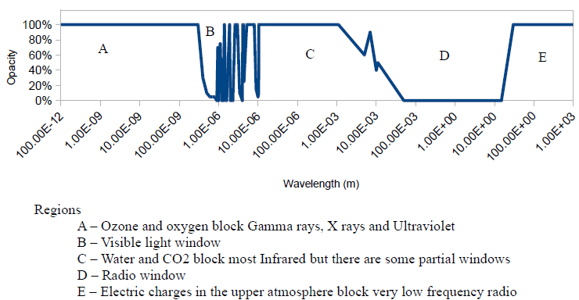
Atmospheric Windows (again)
Notes:
Atmospheric windows are wavelength ranges where Earth’s atmosphere is relatively transparent, letting radiation from the surface (or a target) pass to a sensor with low absorption. Outside these windows, gases like H₂O, CO₂, O₃, O₂, CH₄ and aerosols/clouds strongly absorb or scatter light.

Slide 6
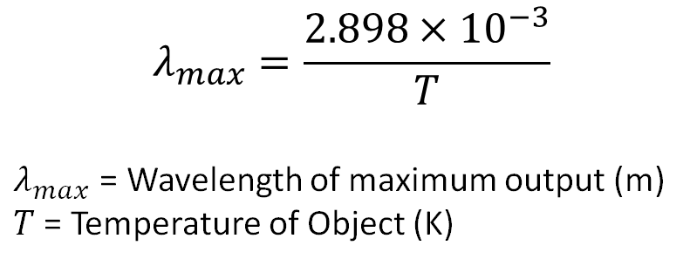
Wein’s Law
Describes the relationship between the temperature of a blackbody (an ideal perfect emitter of radiation) and the wavelength at which it emits radiation most strongly.
$$λ_{max}=\frac{2.898×{10}^{−3}}{T}$$
$λ_{max}$ = Wavelength of maximum output (m)
$T$ = Temperature of Object (K)
Hotter objects emit at shorter wavelengths.
→As temperature increases, the emission peak shifts toward the blue/UV end of the spectrum.
Cooler objects emit at longer wavelengths.
→Lower temperatures shift the peak toward the red/infrared.
How do we use this?
When we start observing an object, our design will be easier if we can study the wavelength that produces the maximum output.
Notes:
A black body is an idealized physical object that:
Absorbs 100% of incident electromagnetic radiation at all wavelengths and angles
Reflects 0% and transmits 0%
Emits the maximum possible radiation for its temperature
It is a theoretical reference model — not a real material — but many natural objects approximate blackbody behavior closely enough for remote sensing analysis.

Slide 7
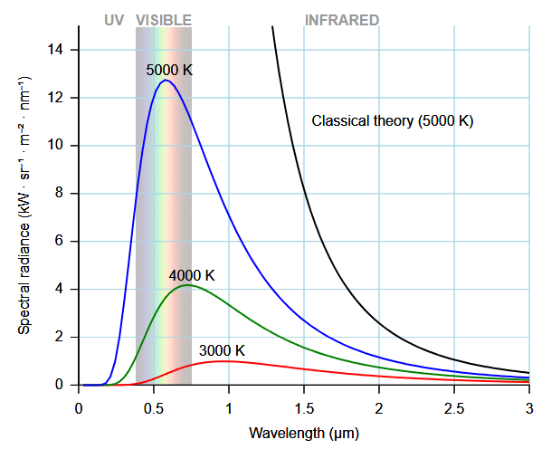
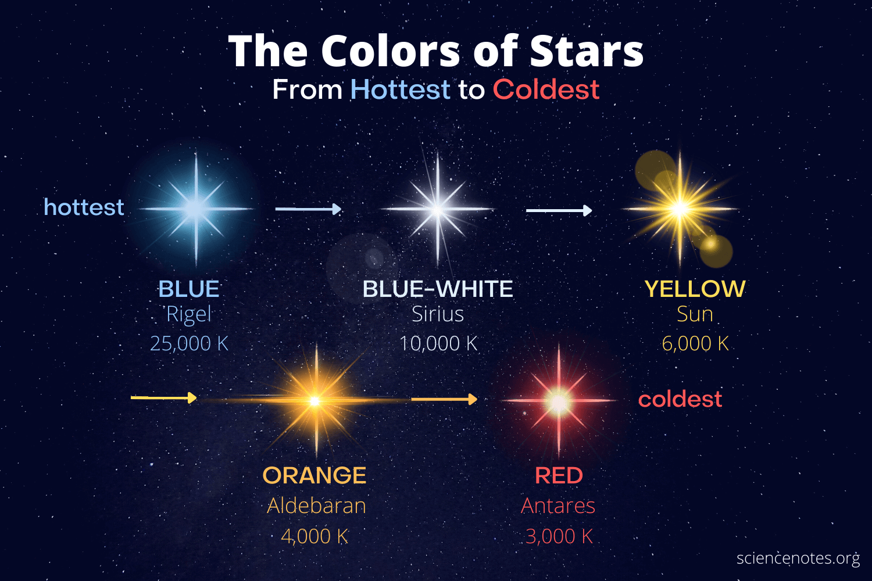
Wein’s Law
As the temperature decreases, the total amount of energy radiated decreases and the wavelength of the peak increases.
Notes:
Stars behave very close to blackbody radiators. Their surface temperature sets the shape of their emission spectrum, which determines perceived color.
From blackbody radiation physics (Wien + Planck):
Higher temperature → peak emission at shorter wavelengths → bluer appearance
Lower temperature → peak emission at longer wavelengths → redder appearance
Then Why Aren’t There Green Stars?
This is a spectral mixing + human vision issue — not a physics limitation.
Key Reason: Stars Emit Broad Spectra — Not Narrow Colors
A star does not emit at just one wavelength. It emits a continuous spectrum across visible light.
Even if a star’s peak wavelength falls in the green region (~500–550 nm):
It still emits substantial red and blue light
The combined visible output appears white or yellowish, not green
Example:
A ~5800 K star (like the Sun) peaks near green
But because red + green + blue are all strong → your eye perceives white
Human color perception works by combining signals from three cone types:
Red-sensitive cones
Green-sensitive cones
Blue-sensitive cones
A blackbody spectrum near the green peak stimulates all three cones strongly → interpreted as white, not green.
To appear green, a source must emit:
Strong green
Weak red
Weak blue
Stars do not produce that kind of narrowband spectrum.

Slide 8
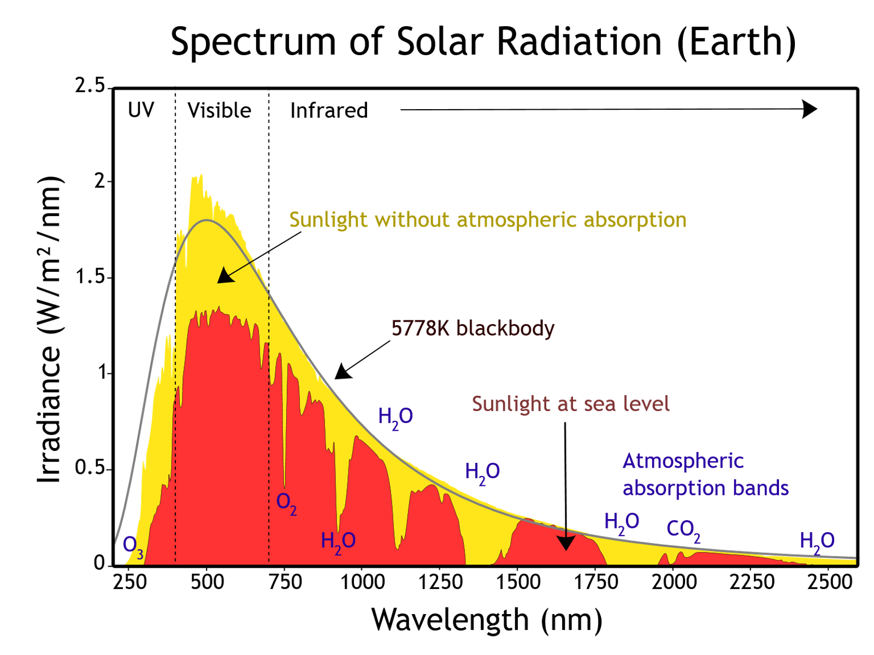
Solar Radiation
Combining Wein’s Law & Atmospheric Windows for solar radiation:

Slide 9
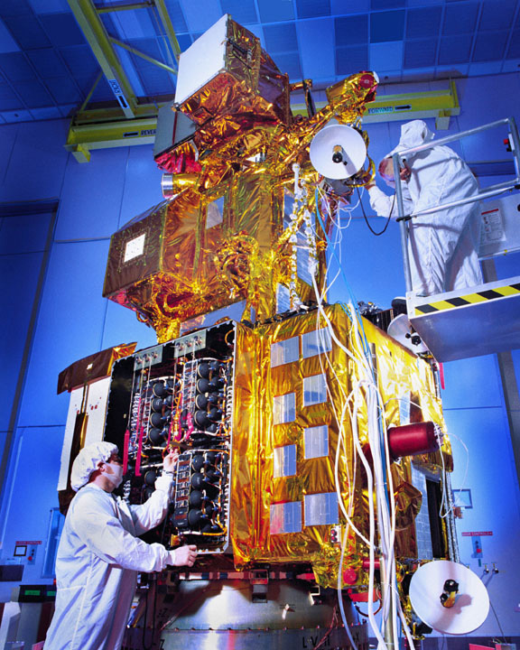
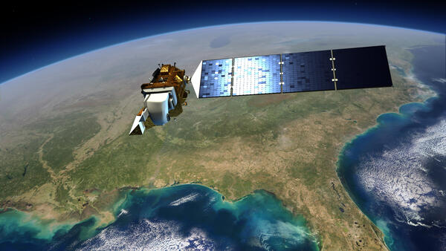
Remote Sensing
Remote sensing: the acquisition of information about an object or area without physical contact, typically by detecting energy (most often electromagnetic radiation) reflected or emitted from the target.
Sensors are mounted on satellites, aircraft, drones, or the ground.
Passive Remote Sensing: measure natural radiation (e.g., reflected sunlight in VNIR/SWIR, emitted thermal IR).
→ Examples: multispectral/hyperspectral cameras, thermal imagers.
Active Remote Sensing: sensor emits energy and measure the return.
→ Examples: LiDAR (laser ranging), SAR radar (microwave), sonar (underwater).
The Landsat program is the longest-running enterprise that has acquired satellite imagery of Earth.
Notes:
Remote sensing is the process of detecting and monitoring the physical characteristics of an area by measuring its reflected and emitted radiation at a distance (typically from satellite or aircraft). Special cameras collect remotely sensed images, which help researchers "sense" things about the Earth. Some examples are:
- Cameras on satellites and airplanes take images of large areas on the Earth's surface, allowing us to see much more than we can see when standing on the ground.
- Sonar systems on ships can be used to create images of the ocean floor without needing to travel to the bottom of the ocean.
- Cameras on satellites can be used to make images of temperature changes in the oceans.
Some specific uses of remotely sensed images of the Earth include:
- Large forest fires can be mapped from space, allowing rangers to see a much larger area than from the ground.
- Tracking clouds to help predict the weather or watching erupting volcanoes, and help watching for dust storms.
- Tracking the growth of a city and changes in farmland or forests over several years or decades.
- Discovery and mapping of the rugged topography of the ocean floor (e.g., huge mountain ranges, deep canyons, and the “magnetic striping” on the ocean floor).
from [USGS.gov](https://www.usgs.gov/faqs/what-remote-sensing-and-what-it-used)

Slide 10
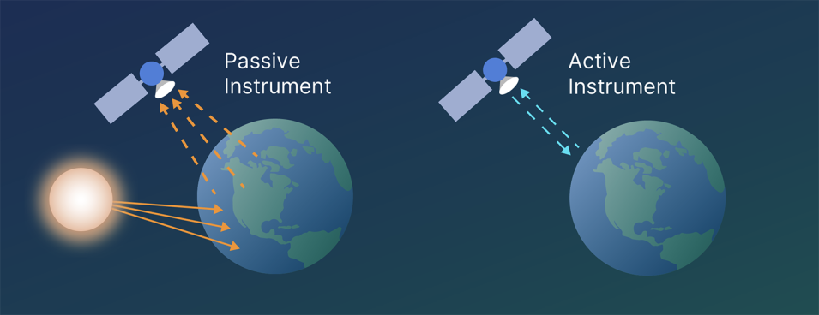
Passive vs. Active Sensors
Feature | Passive Sensor | Active Sensor
Energy source | Natural (sun, Earth emission) | Artificial (sensor-generated signal)
Day/night capability | Limited (depends on sun/thermal emission) | Works both day and night
Cloud penetration | Limited (except microwave/thermal) | Can penetrate clouds (radar, some LiDAR)
Examples | Optical imagers, thermal sensors, radiometers | SAR, LiDAR, radar altimeters
Cost/complexity | Lower | Higher
Notes:
https://www.earthdata.nasa.gov/learn/earth-observation-data-basics/remote-sensing
Passive instruments include different types of radiometers (instruments that quantitatively measure the intensity of electromagnetic radiation in select bands) and spectrometers (devices that are designed to detect, measure, and analyze the spectral content of reflected electromagnetic radiation). Most passive systems used by remote sensing applications operate in the visible, infrared, thermal infrared, and microwave portions of the electromagnetic spectrum. These instruments measure land and sea surface temperature, vegetation properties, cloud and aerosol properties, and other physical attributes. Most passive instruments cannot penetrate dense cloud cover and thus have limitations observing areas like the tropics where dense cloud cover is frequent.
Active instruments include different types of radio detection and ranging (radar) instruments, altimeters, and scatterometers. The majority of active instruments operate in the microwave band of the electromagnetic spectrum, which gives them the ability to penetrate the atmosphere under most conditions. These types of instruments are useful for measuring the vertical profiles of aerosols, forest structure, precipitation and winds, sea surface topography, and ice, among other criteria.
Passive Sensors
Definition: Detect natural radiation that is emitted or reflected from the Earth’s surface or atmosphere.
Energy Source: Sunlight (most common) or naturally emitted thermal radiation from the Earth.
Examples:
Cameras (visible spectrum, using reflected sunlight).
Multispectral/hyperspectral imagers (Landsat, Sentinel-2).
Infrared radiometers (thermal imaging satellites).
Radiometers for microwave frequencies (e.g., measuring soil moisture, sea surface temperature).
Advantages:
Simple design, often less power-intensive.
Natural spectral coverage across many wavelengths.
Long heritage in Earth observation (decades of optical/IR imaging).
Limitations:
Only work when natural illumination is present (daylight for optical, clear skies for some bands).
Can be blocked by clouds, dust, or nighttime (except thermal infrared/microwave).
Active Sensors
Definition: Emit their own signal and measure the reflection/scattering from the target.
Energy Source: Onboard transmitter (laser, radar, LiDAR).
Examples:
Synthetic Aperture Radar (SAR): Uses microwaves to image surface structures (e.g., Sentinel-1, RADARSAT).
LiDAR (Light Detection and Ranging): Uses laser pulses to measure topography, vegetation canopy, or atmosphere.
Radar altimeters: Measure sea surface height or ice thickness.
Advantages:
Operate day or night (independent of the sun).
Can penetrate clouds, vegetation, or even soil (depending on wavelength).
Provide direct measurements of structure (e.g., elevation, surface roughness).
Limitations:
More complex and power-hungry.
Narrower spectral coverage compared to passive optical systems.
Often more expensive to build and operate.

Slide 11
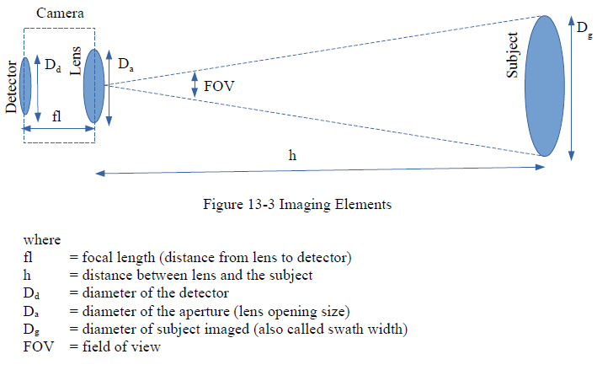
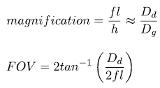
Imaging Sensors (Dahlke)

Slide 12
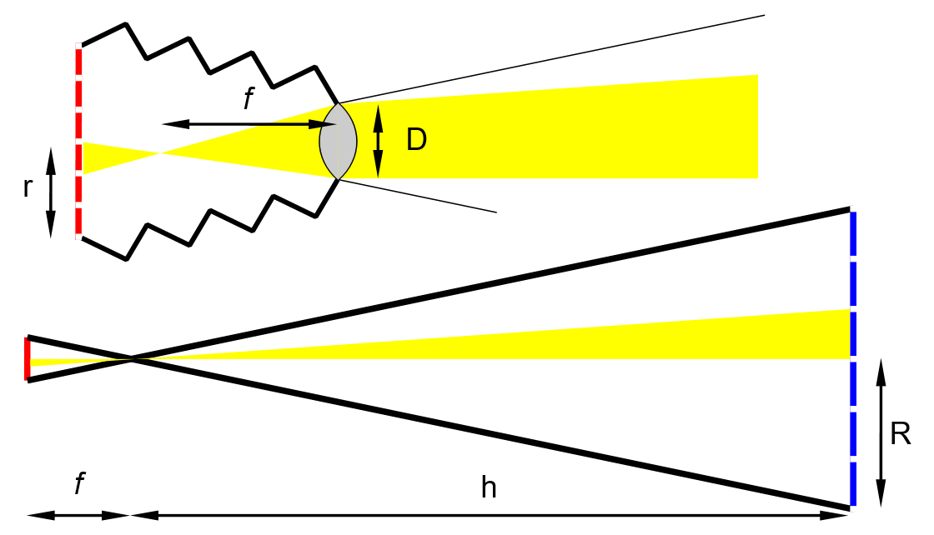

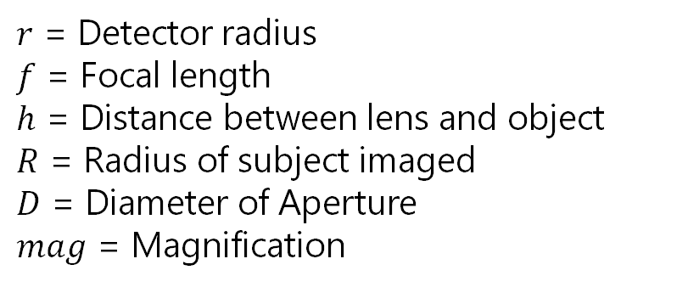
Imaging Sensors (Equation Sheet)
$r$ = Detector radius
$f$ = Focal length
$h$ = Distance between lens and object
$R$ = Radius of subject imaged
$D$ = Diameter of Aperture
$mag$ = Magnification

Slide 13
Resolution
The smallest interval measurable by a scientific (especially optical) instrument; the resolving power.
→The degree of detail visible in a photographic or television image.
Alternatively:
The act, process, or capability of distinguishing between two separate but adjacent objects or sources of light or between two nearly equal wavelengths

Slide 14
Types of Resolution
Spatial resolution
→“How small a thing can I see?”
2) Spectral resolution
→ “Which wavelengths can I separate?”
3) Radiance/Radiometric resolution
→ “How finely can I grade brightness?”
4) Temporal resolution
→ “How often can I sample in time?”

Slide 15
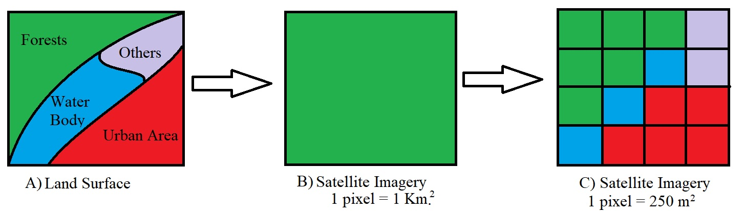
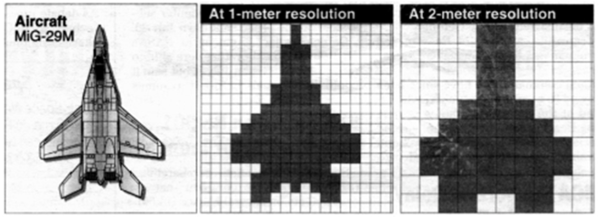
Spatial Resolution
Smallest separable detail in space (fine texture, thin lines).
Limited by: Diffraction, pixel size, focal length, focus/aberrations, motion blur.
How to improve it: Longer focal length, closer standoff, smaller pixels, lower f-number, better optics, shorter exposure/less motion.

Slide 16
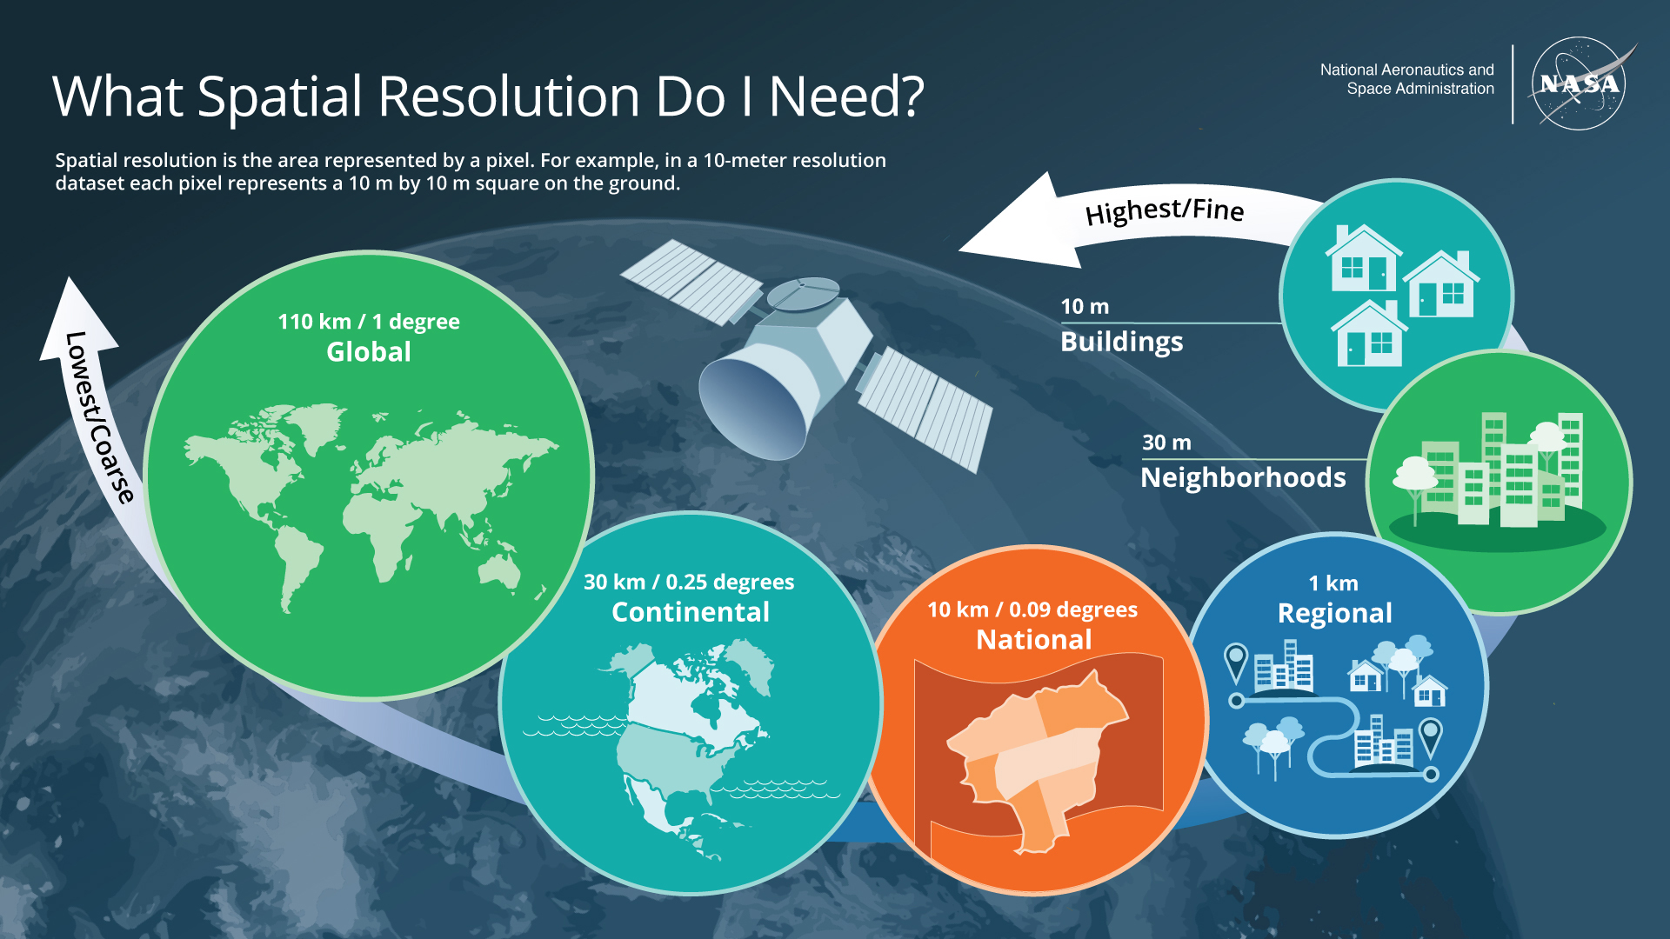
Spatial Resolution (2)
Notes:
https://www.earthdata.nasa.gov/learn/earth-observation-data-basics/remote-sensing

Slide 17
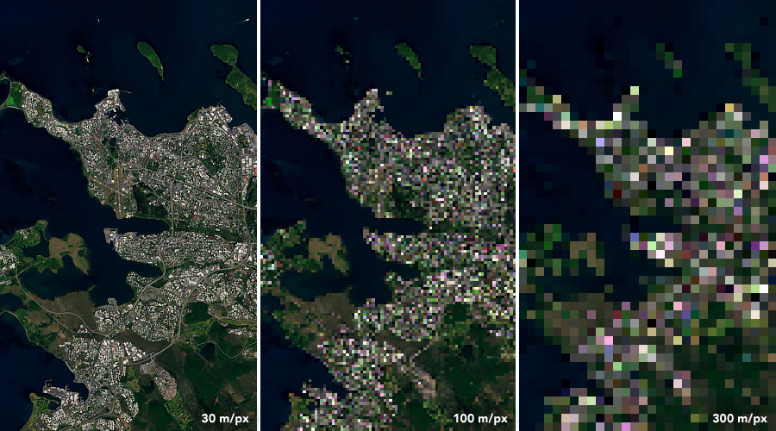
Spatial Resolution (3)
Landsat 8 image of Reykjavik, Iceland, acquired July 7, 2019, illustrating the difference in pixel resolution. Credit: NASA Earth Observatory.

Slide 18
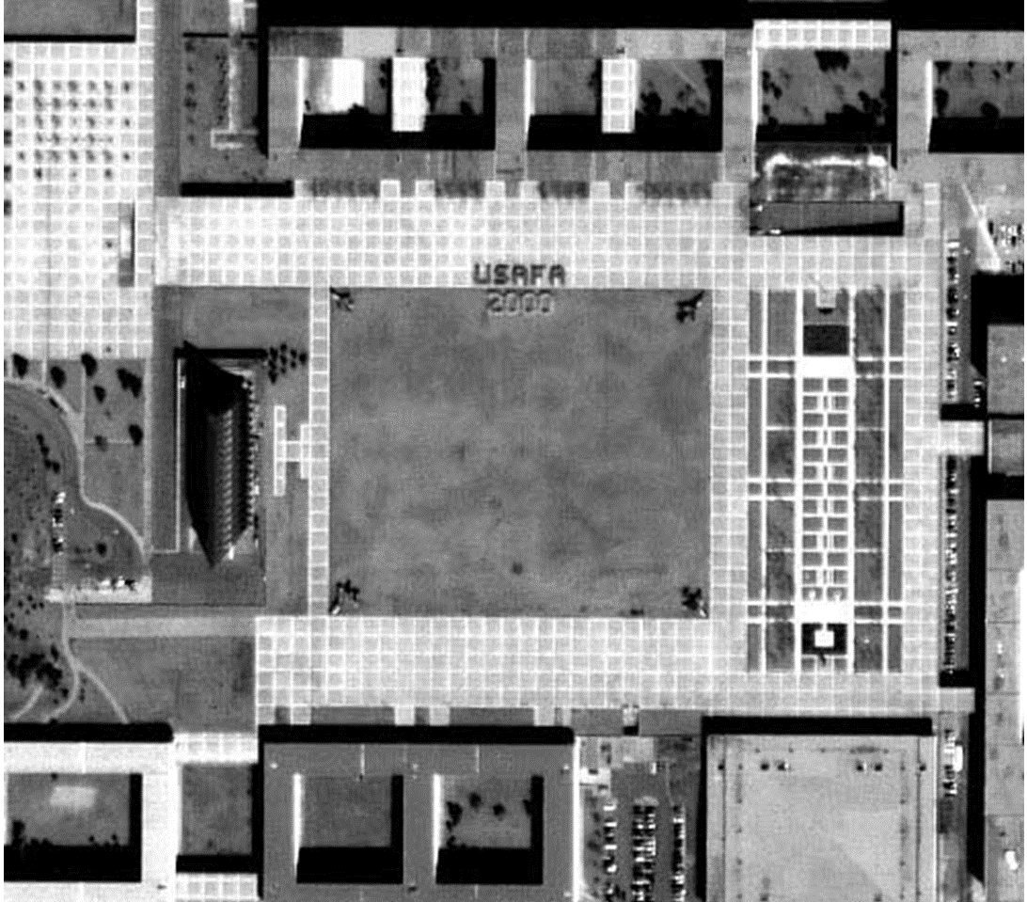
Spatial Resolution (4)

Slide 19
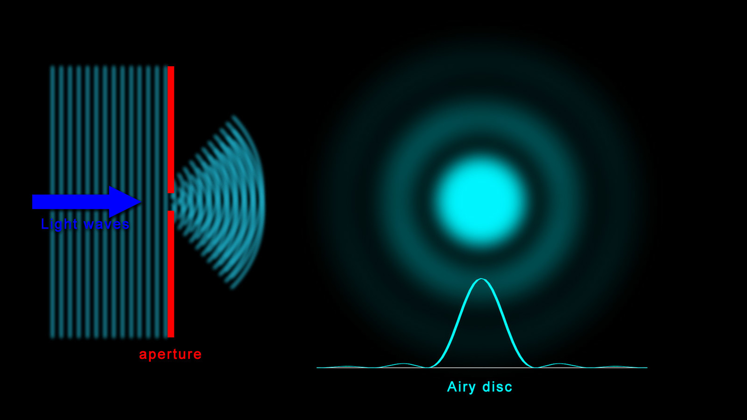
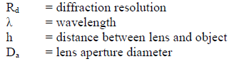
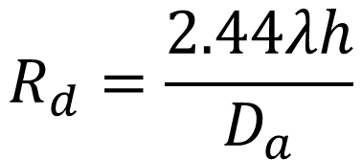
Spatial Resolution: Diffraction Resolution
When a photon hits the camera detector, it is not collected at a single point due to wave-like properties of photons.
The photon’s energy is spread out on the detector in a pattern called an Airy disk.
This spreading of energy limits resolution.
$$R_{d}=\frac{2.44λh}{D_{a}}$$
Notes:
The diffraction resolution can be improved (made smaller) by decreasing the wavelength or distance to the subject, or be increasing the diameter of the aperture.
Independent of quality of lens.
An Airy disk is the central bright spot in the diffraction pattern produced when light from a point source passes through a circular aperture (lens, telescope, camera, sensor optics).
Even a perfect, aberration-free optical system cannot focus light to an infinitesimal point. Due to wave diffraction, the image of a point source becomes:
Bright central spot (Airy disk)
Surrounded by concentric dim rings
This full pattern is the point spread function (PSF) of a circular aperture
This sets the fundamental resolution limit of imaging systems — including telescopes and remote sensing instruments.

Slide 20
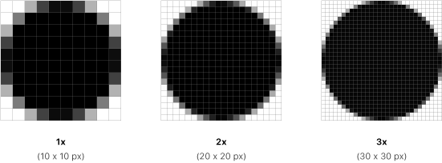
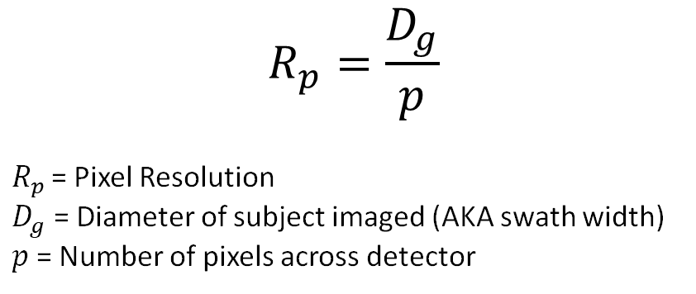
Spatial Resolution: Pixel Resolution
The number of pixels on a detector also dictate the amount of detail captured → Pixel Resolution
$$R_{p}=\frac{D_{g}}{p}$$
$R_{p }$= Pixel Resolution
$D_{g}$ = Diameter of subject imaged (AKA swath width)
$p$ = Number of pixels across detector

Slide 21
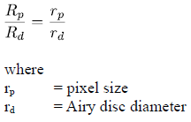
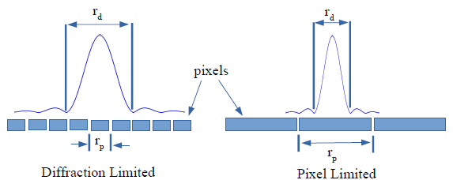


Spatial Resolution: Resolution Limitation
If $R_{p}$ < $R_{d}$ then the sensor is diffraction limited.
If $R_{p}$ > $R_{d}$ then it is pixel limited.
Why do we care?
It is best to have $R_{p}$ and $R_{d}$ close to each other, because otherwise you’ve wasted money over-designing either the sensor or the lens aperture.

Slide 22
Types of Resolution
Spatial resolution
→“How small a thing can I see?”
2) Spectral resolution
→ “Which wavelengths can I separate?”
3) Radiance/Radiometric resolution
→ “How finely can I grade brightness?”
4) Temporal resolution
→ “How often can I sample in time?”

Slide 23
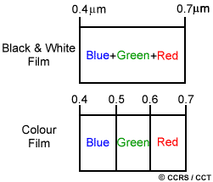
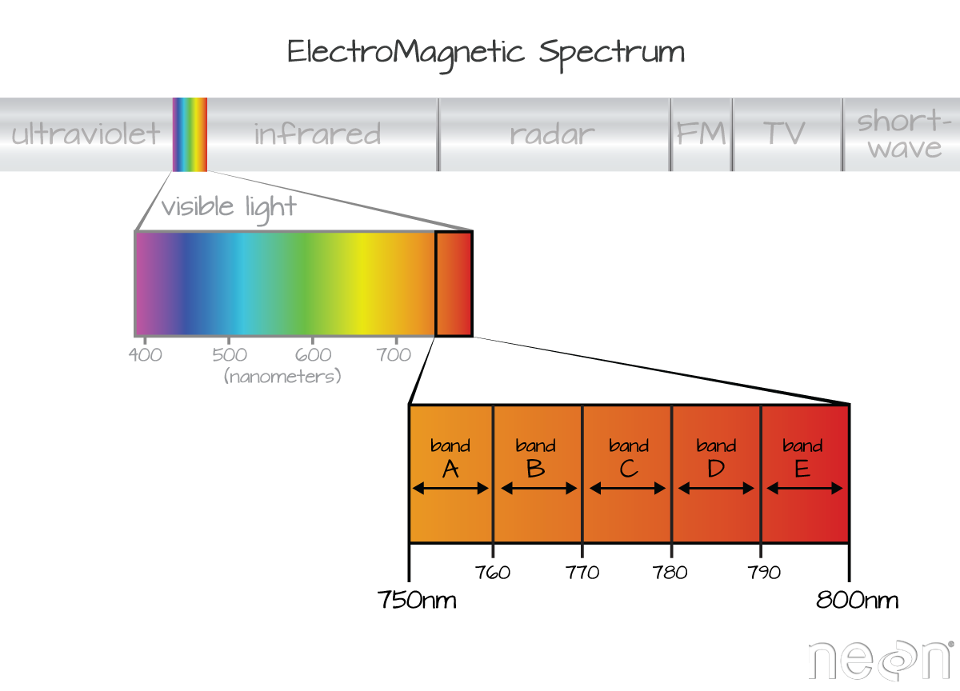
Spectral Resolution
Ability to distinguish wavelength bands.
How it’s measured: Number and bandwidth of bands (e.g., RGB vs. 8-band multispectral vs. hyperspectral).
Trade-off: Narrower bands = better spectral detail but less light per band → lower SNR or longer exposure.
Notes:
Spectral – This is how narrow of a frequency band that we can observe. For example blue light is approximately 400-500 nm. Our sensor may be able to view that band. However, for higher Spectral resolution, we could divide that into ten bands instead and observe 400-410nm, 410-420nm, …, 480-500nm, giving us information about several shades of blue.

Slide 24
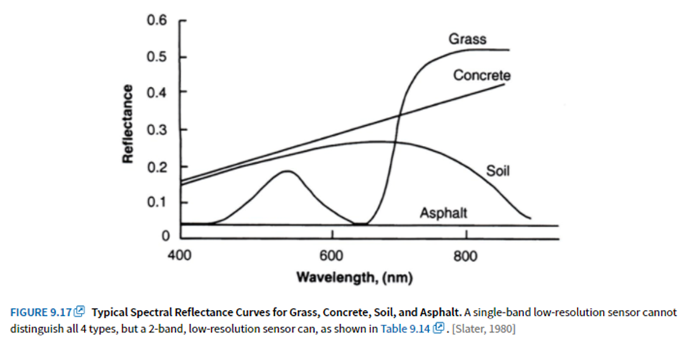
Spectral Resolution (2)

Slide 25
Types of Resolution
Spatial resolution
→“How small a thing can I see?”
2) Spectral resolution
→ “Which wavelengths can I separate?”
3) Radiance/Radiometric resolution
→ “How finely can I grade brightness?”
4) Temporal resolution
→ “How often can I sample in time?”

Slide 26
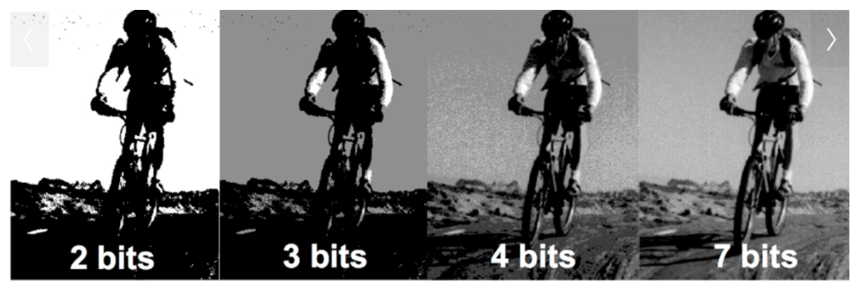
Radiance/Radiometric Resolution
Smallest detectable intensity difference.
How it’s measured: Bit depth (8/10/12/14-bit), dynamic range, SNR, ENOB (effective number of bits).
Limited by: Sensor full-well capacity, read noise, dark noise, quantization, lighting.
Improve it: More light (aperture/exposure/illumination), lower read noise, HDR, cooling (for long exposures), better ADC/processing.
Notes:
Radiance (or Radiometric) – This is how accurately we can measure the brightness of something. It is often related to the number of bits allotted to each pixel. For example if a pixel has 1 bit, it can only be one of two values, either be white or black. If the pixel has 8 bits, it can have 256 different values allowing us much higher Radiance resolution, storing white to black with 256 different shades of gray.

Slide 27
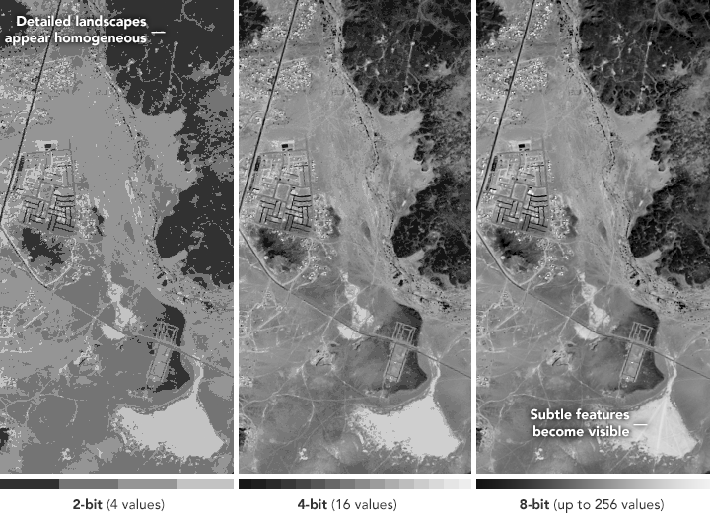
Radiance/Radiometric Resolution (2)

Slide 28
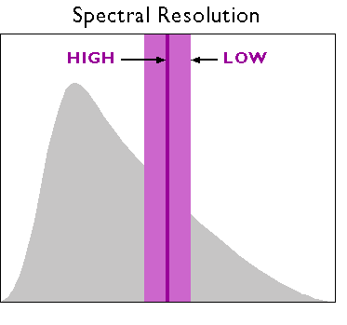
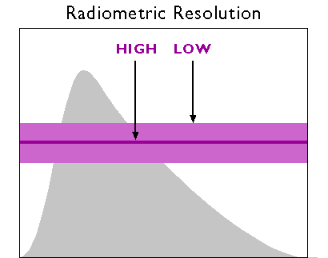
Spectral vs Radiometric Resolution
Intensity
wavelength
wavelength
Plots depict examples of high and low resolution for given type
Notes:
https://www.e-education.psu.edu/geog160/node/1959
Spectral resolution. The area under the curve represents the magnitude of electromagnetic energy emitted by the Sun at various wavelengths. Low resolution sensors record energy within relatively wide wavelength bands (represented by the lighter and thicker purple band). High-resolution sensors record energy within narrow bands (represented by the darker and thinner band).
Radiometric resolution. The area under the curve represents the magnitude of electromagnetic energy emitted by the Sun at various wavelengths. Sensors with low radiometric resolution are able to detect only relatively large differences in energy magnitude (as represented by the lighter and thicker purple band). Sensors with high radiometric resolution are able to detect relatively small differences (represented by the darker and thinner band).

Slide 29
Types of Resolution
Spatial resolution
→“How small a thing can I see?”
2) Spectral resolution
→ “Which wavelengths can I separate?”
3) Radiance/Radiometric resolution
→ “How finely can I grade brightness?”
4) Temporal resolution
→ “How often can I sample in time?”

Slide 30
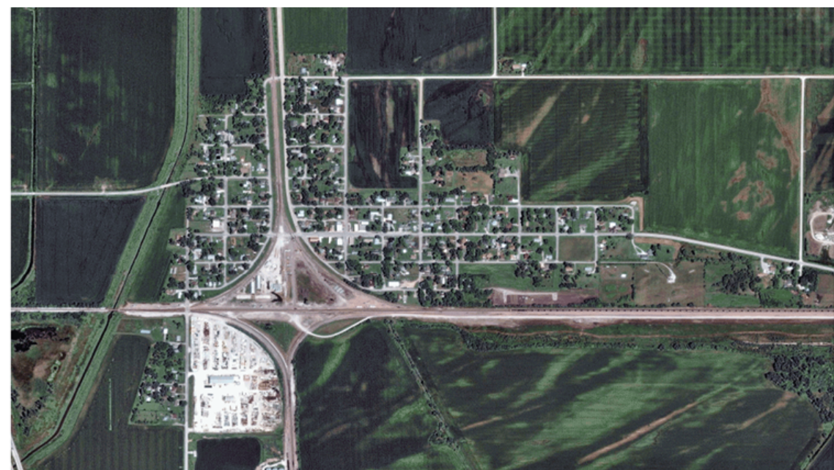
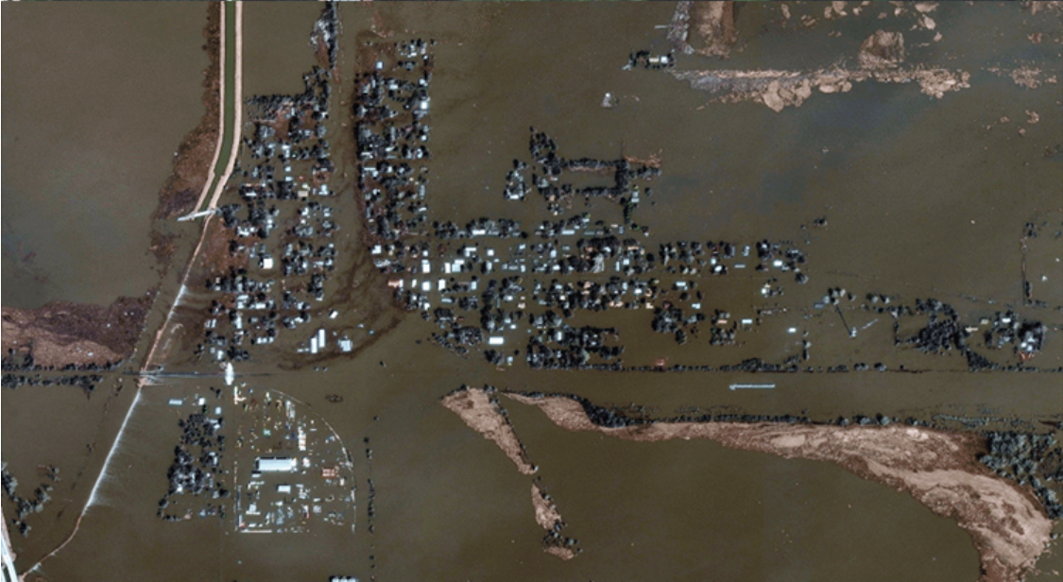
Temporal Resolution
Ability to resolve changes over time.
How it’s measured: Frame rate (fps), exposure time, revisit rate.
Trade-off: Higher fps or shorter exposure reduces light per frame → potential SNR loss; rolling vs. global shutter matters for motion.

Slide 31
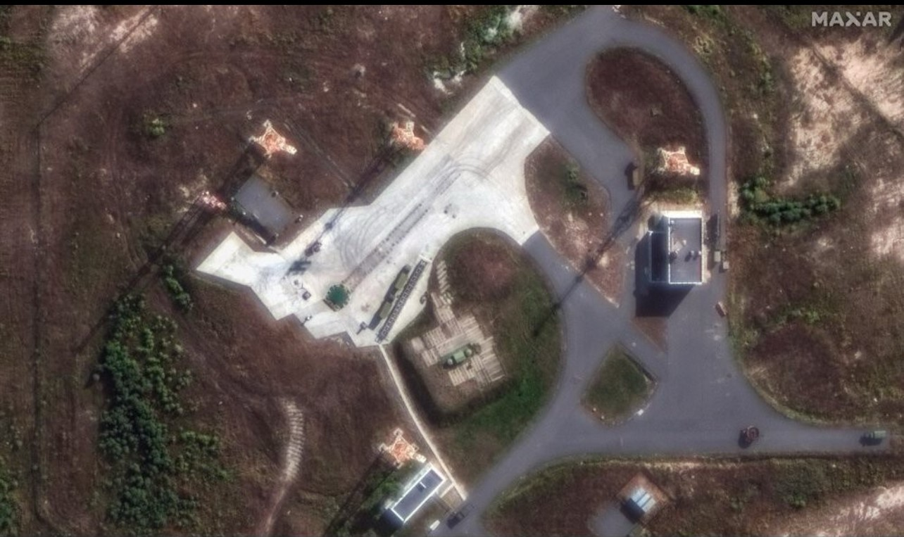
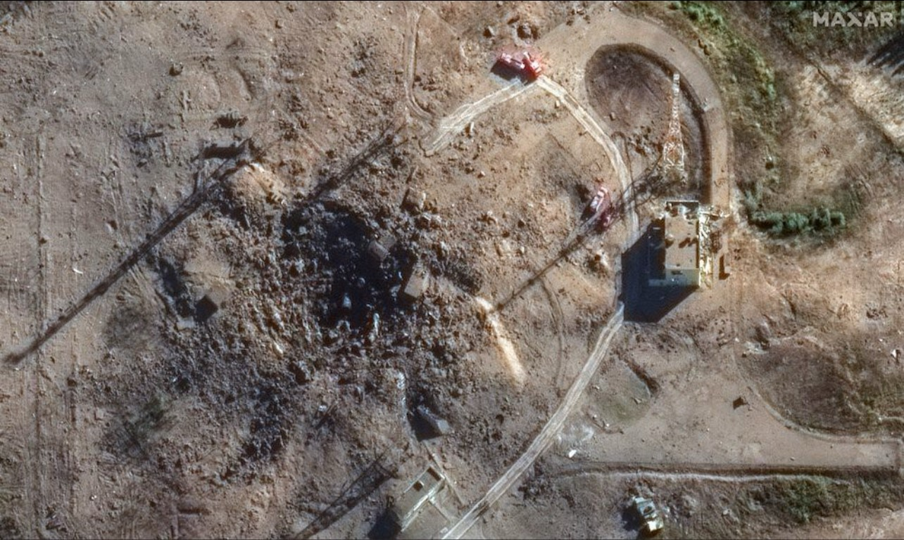
Temporal Resolution (2)

Slide 32
Extra Topics

Slide 33
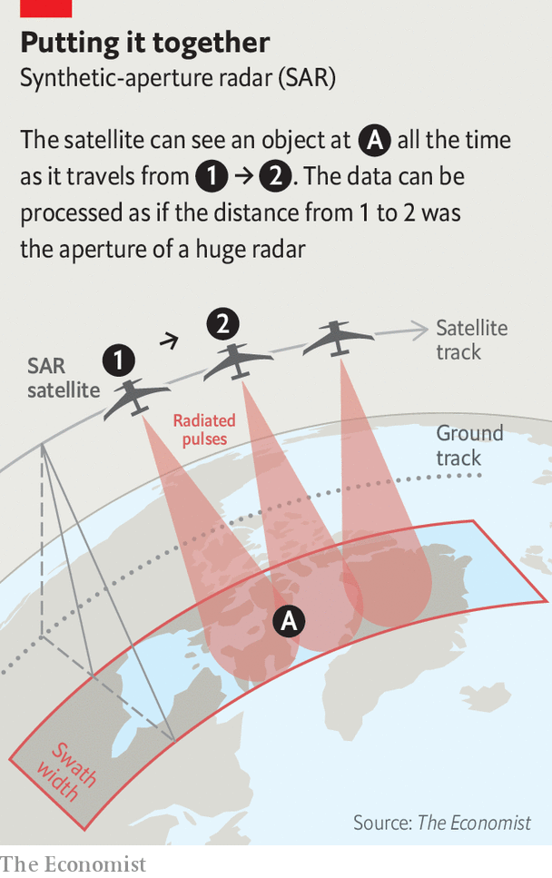
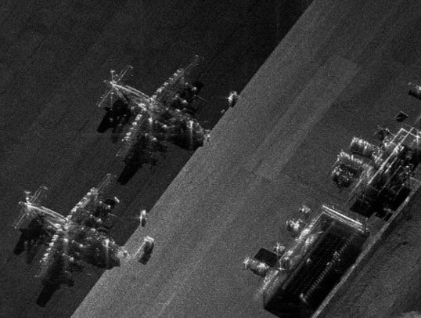
Synthetic Aperture Radar (SAR)
Notes:
Synthetic Aperture Radar (SAR) is an active remote sensing system that uses microwave radar to create high-resolution images of the Earth’s surface.
Unlike optical sensors, SAR works day or night and can see through clouds, smoke, and even some vegetation and soil, depending on wavelength.
How it Works
A radar antenna on a satellite or aircraft emits microwave pulses toward the ground.
The pulses scatter off the Earth’s surface and return to the antenna.
By measuring the time delay (distance) and phase (waveform shift), SAR builds up detailed information about the terrain.
The "Synthetic Aperture" Trick
Normally, radar resolution depends on the physical size of the antenna: bigger antennas = sharper images.
A satellite can’t carry a 1-kilometer-long antenna — so SAR uses the motion of the platform to simulate one.
As the radar platform moves, it records echoes from each point on the ground over time.
These echoes are combined with advanced signal processing to create the effect of a much larger antenna — a synthetic aperture.
Result: very high-resolution images (as fine as 25 cm from space).
Key Features
All-weather capability: Penetrates clouds and darkness.
Polarization: SAR can transmit/receive in horizontal or vertical polarization (HH, HV, VH, VV), giving extra information about surface structure.
Interferometry (InSAR): Using two SAR images of the same area, scientists can measure tiny ground movements (mm-scale) — useful for earthquakes, volcanoes, and glaciers.
Coherence: SAR can track changes over time, detecting land cover changes, deforestation, or urban growth.
Example Missions
Sentinel-1 (ESA): Europe’s free, open SAR dataset — widely used for environmental monitoring.
RADARSAT (Canada): Maritime and Arctic surveillance.
TerraSAR-X (Germany): Commercial high-resolution imagery.
NISAR (NASA–ISRO, launching 2025): Will provide global L- and S-band SAR for climate and hazard monitoring.
Synthetic Aperture Radar (SAR) doesn’t belong to one single electromagnetic (EM) band—it’s a technique that can be applied across several microwave frequency bands.
Here’s how it typically breaks down:
P-band (~0.3–1 GHz): Long wavelength (~30–100 cm). Can penetrate vegetation, soil, and even some dry sand—useful for subsurface studies.
L-band (~1–2 GHz): Wavelength ~15–30 cm. Good for vegetation monitoring, forestry, and soil moisture.
S-band (~2–4 GHz): Wavelength ~7.5–15 cm. Less common, used in some specialized systems.
C-band (~4–8 GHz): Wavelength ~3.8–7.5 cm. Widely used (e.g., ESA Sentinel-1). Balanced between resolution and vegetation penetration.
X-band (~8–12 GHz): Wavelength ~2.5–3.8 cm. High-resolution imaging, used in TerraSAR-X, COSMO-SkyMed, military reconnaissance.
Ku/Ka-band (>12 GHz): Shorter wavelengths (<2.5 cm). Used in experimental or airborne SAR systems for very high resolution, though more affected by atmosphere and rain.
Summary: SAR is a radar imaging technique that uses microwave frequencies (roughly 0.3–40 GHz), most commonly in L, C, and X bands. The choice of band depends on the trade-off between resolution, penetration (through vegetation/ground), and atmospheric effects.

Slide 34

What’s going on here?
Notes:
One of the most dramatic and secretive chapters in Cold War reconnaissance history — the story of CORONA film recovery by aircraft…
The CORONA Program
In the late 1950s, the U.S. developed the CORONA series of spy satellites to photograph the Soviet Union and other strategic areas.
These satellites carried film-based cameras — this was before digital imaging.
Once the film was used up, there was no way to beam images back to Earth. Instead, the film had to be physically returned.
Film Return Capsules
The satellites carried reentry capsules (nicknamed “film buckets”).
After the satellite’s mission ended, the capsule was ejected, reentered the atmosphere with a heat shield, and deployed a parachute.
Inside was the precious exposed film with high-resolution images of Soviet missile silos, airbases, and shipyards.
Mid-Air Recovery
To prevent the capsule from landing in the ocean (and possibly being lost or recovered by adversaries), the U.S. Air Force developed a daring recovery method:
C-119 “Flying Boxcar” (later JC-130 Hercules) aircraft were equipped with special hooks and winches.
As the capsule parachuted down, recovery planes would fly underneath it and snag the parachute cord with a trapeze-like mechanism.
Once caught, the capsule was reeled into the aircraft’s cargo bay.
If the plane missed, Navy ships and submarines were stationed for ocean recovery — but this was riskier, since film could be damaged by seawater.
This maneuver was called airborne midair retrieval (MAR) and was first successfully performed in 1960.
Challenges
The capsules were small (about the size of a trash can) and fell at high speed before their parachute slowed them.
Timing was critical — the recovery plane had to be at the exact spot in the Pacific Ocean where the capsule was expected to descend, based on precise orbital tracking.
Crews sometimes missed, and capsules occasionally sank before they could be recovered. But overall, the system proved remarkably successful.
Significance
The CORONA program (1959–1972) produced over 800,000 images, giving the U.S. an unprecedented view of the Soviet Union and reshaping intelligence capabilities.
It showed that the USSR had fewer missiles than feared, which helped cool some of the nuclear panic of the early 1960s.
CORONA’s success paved the way for later reconnaissance programs and today’s digital spy satellites.
In 1972, the last CORONA capsule ever launched splashed down in the Pacific and was recovered by the USS Longview.
Today, some of the old CORONA film is declassified and used by scientists to study glaciers, forests, and archaeological sites, since it provides a detailed historical record of Earth before widespread satellite monitoring.

Slide 35
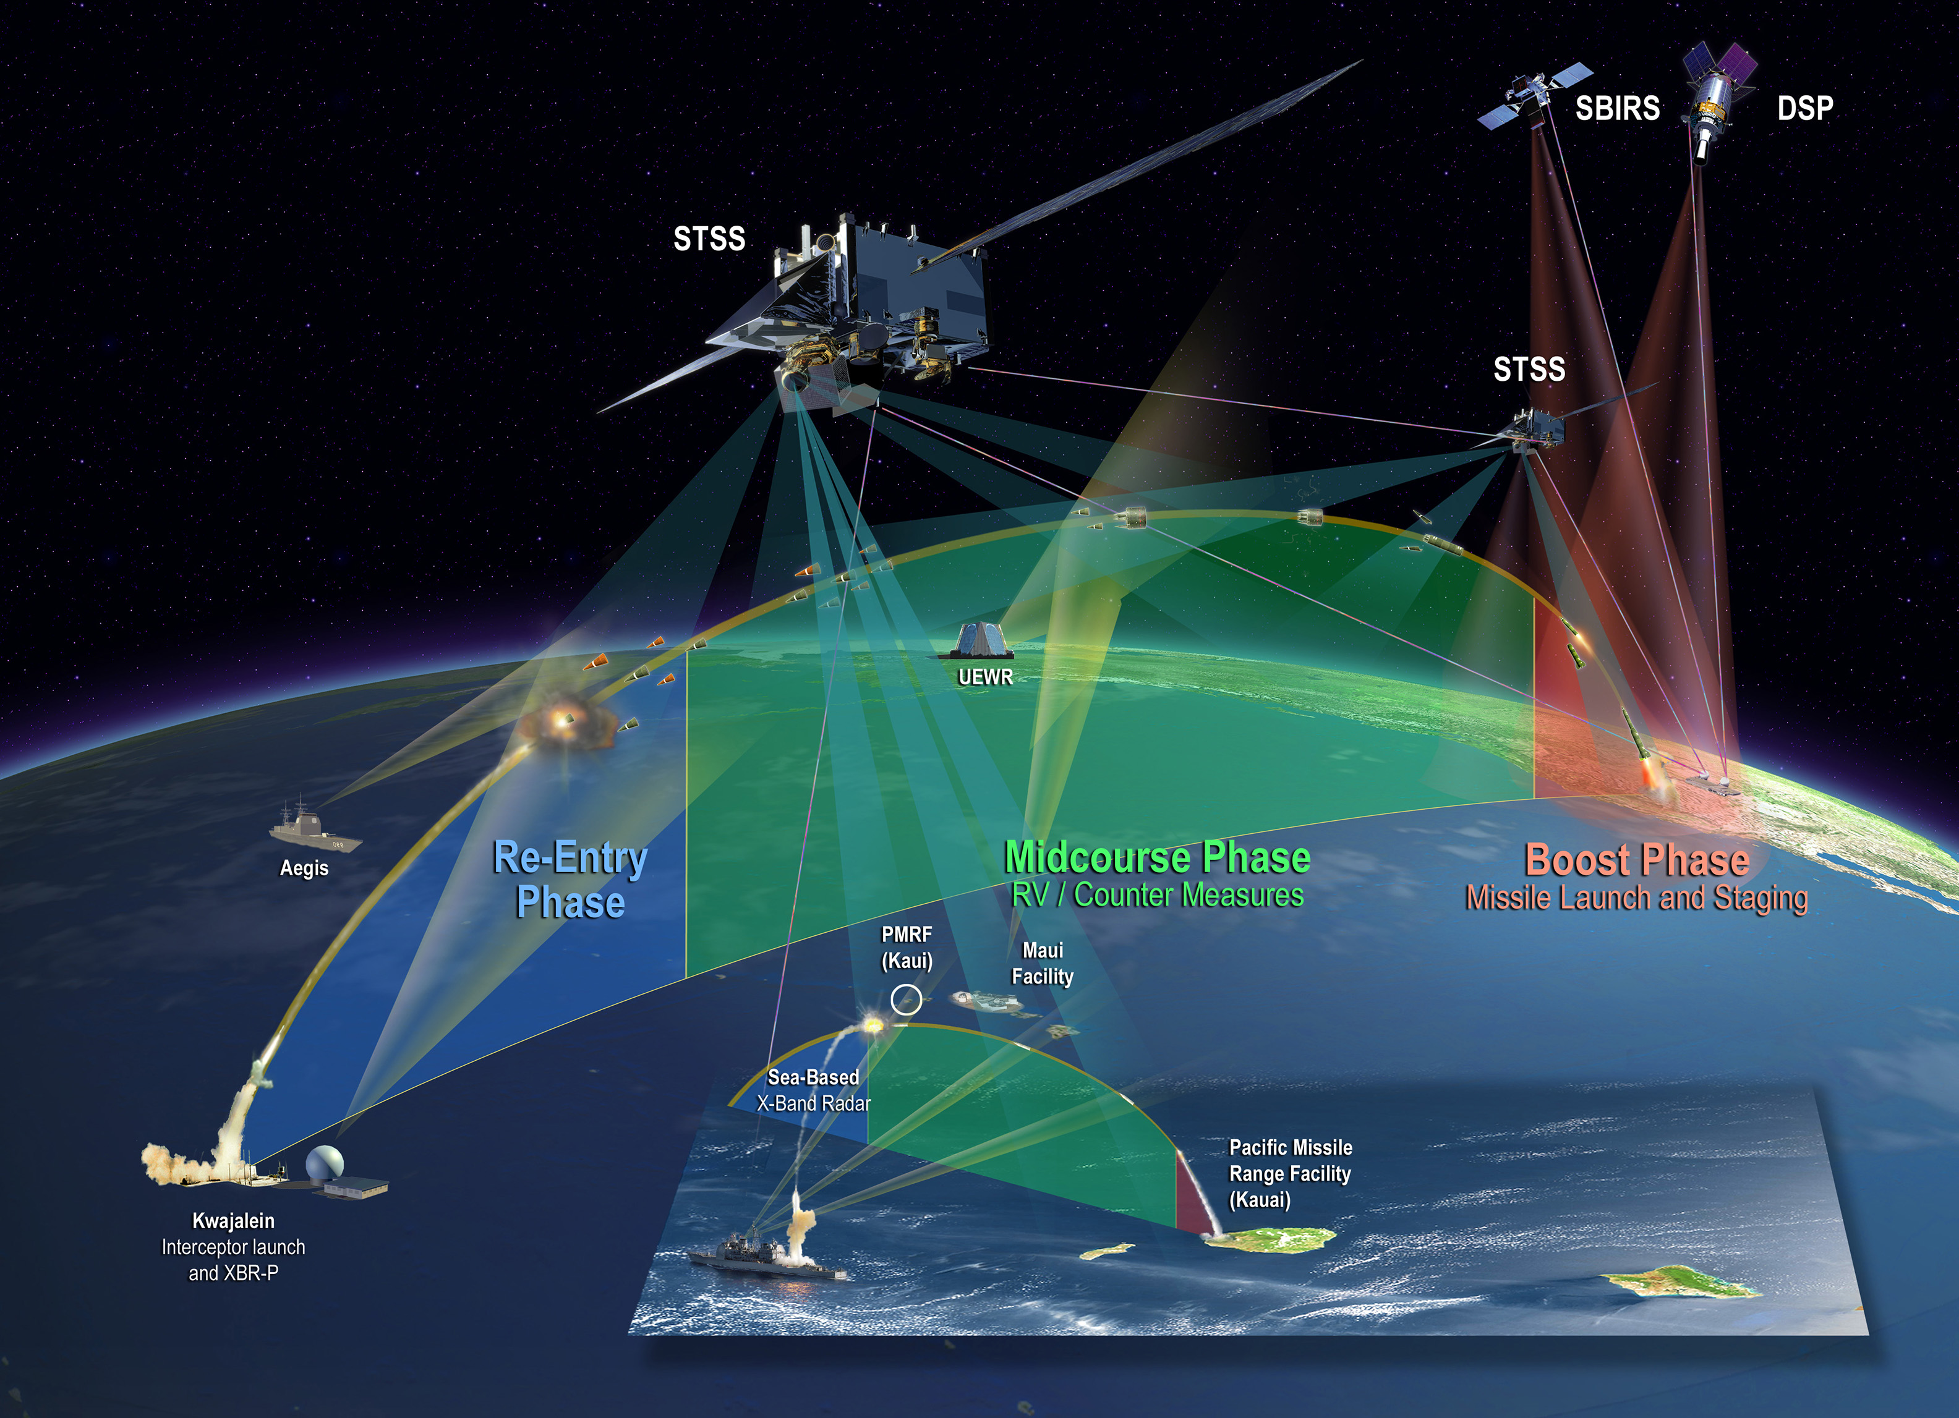
Space-Based Infrared System (SBIRS)
Notes:
The Space-Based Infrared System (SBIRS) is a United States Space Force system intended to meet the United States' Department of Defense infrared space surveillance needs through the first two to three decades of the 21st century. The SBIRS program is designed to provide key capabilities in the areas of missile warning, missile defense, battlespace characterization and technical intelligence via satellites in geosynchronous Earth orbit (GEO), sensors hosted on satellites in highly elliptical orbit (HEO), and ground-based data processing and control.

